Slide 1

Prefixes
Suffixes
Capitals/
Full Stops
Subordination and
Coordination
Commas
Determiners
Plural & Possessive ‘–s’
Verbs
Adjectives
Question/ Exclamation Marks
Present and Past Tense
Conjunctions
Fronted Adverbials
Modal Verbs
Nouns & Pronouns
Adverbs
Commands & Statements
Prepositions
Verb Inflections
Cohesive Devices
Formal and Informal
Apostrophes
Continuous Form of Verbs
Perfect Form of Verbs
Verb Prefixes
Parenthesis
Passive & Active Voice
Colons & Semi Colons
Synonyms & Antonyms
Inverted Commas
Relative Clauses
Noun Phrases
Subjunctive Form
Elision
Hyphens

Slide 2
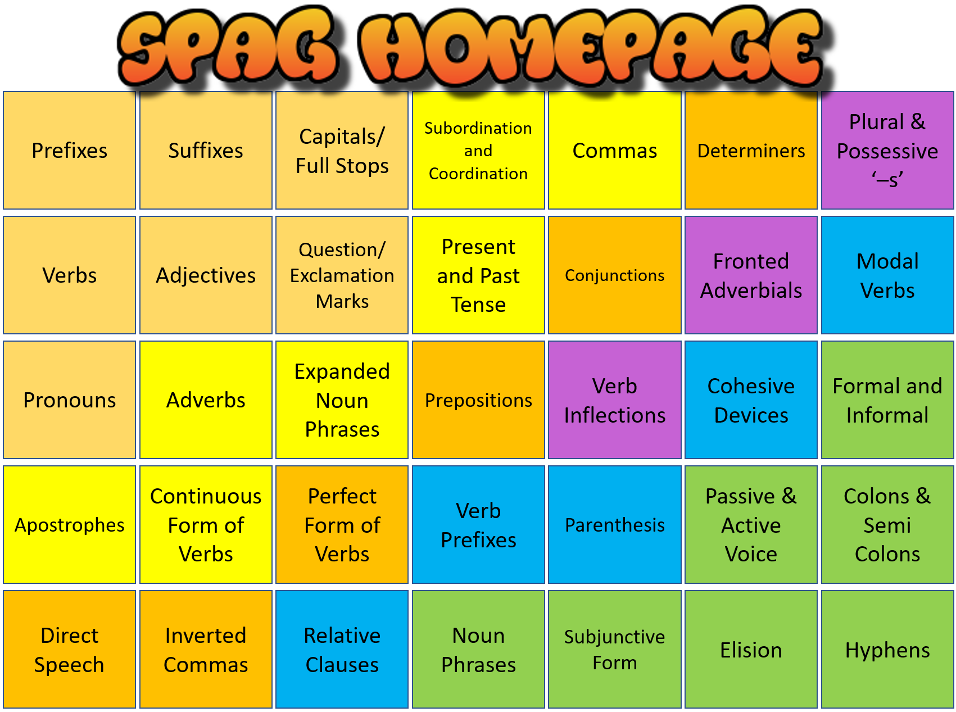


Prefixes
What Do I Need To Know?
Prefixes are a letter or group of letters that go at the beginning of a word
They are added to a root word: (e.g. ‘heat’ = root)
pre + heat
Prefixes can give a word an opposite meaning
un + happy = unhappy
Root words do not change their spelling to allow for a prefix, so don’t add or remove letters when you add a prefix.
Examples:
il: illegal, illogical
im: impossible
in: inactive
ir: irregular, irrelevant
dis: dislike, disagree
un: unnecessary
re: readjust, rebuild
trans: transport
pre: prepaid, preview
auto: autograph/matic
Taster Questions:
YouTube Zone
Before
50 & 51
Developed by www.keystage2literacy.co.uk

Slide 3
Suffixes
What Do I Need To Know?
Suffixes are a letter or group of letters that go at the end of a word.
Like prefixes, they always attach to a root word.
Suffixes form nouns- ment, ness, er, ity
Suffixes form adjectives- less, ful, able, ible
Suffixes form adverbs and verbs- ly, ise, ify, ily
Suffixes change the tense of a verb- ed, ing
Often, if the root word ends in ‘e’ or ‘y’ you drop this off. If a root word ends in a consonant, you need to double it.
Examples: (modification)
happy + ness = happiness
care + er = carer
active + ity = activity
rely + able = reliable
reverse + ible = reversible
want (present) + ed = wanted (past)
run (present) + ing = running
Amazing range of resources…
https://en.islcollective.com/resources/search_result?Tags=suffixes
Taster Questions:
YouTube Zone
Before
52 & 53
Developed by www.keystage2literacy.co.uk

Slide 4
Capital Letters and Full Stops
What Do I Need To Know?
This might seem really obvious but there are a lot of mistakes made on a daily basis, by adults as well as children when it comes to basic sentence punctuation.
A capital letter is needed: at the beginning of a sentence, for the name of a place, person or thing (a proper noun), the word ‘I.’
Full stops are required to finish a sentence. They allow the reader time to stop, breathe and think. Avoid using commas where full stops should go.
Examples:
He wanted to catch fish. The lake was very big.
Darren and Mr Hunter were good at football. They wanted to play for Barcelona in Spain.
Cello lessons begin on the 1st Tuesday in March.
Taster Questions:
YouTube Zone
Before
30
Developed by www.keystage2literacy.co.uk

Slide 5
Verbs
What Do I Need To Know?
Verbs are doing or action words
They tell you what a person or thing is doing or being. It’s not always obvious, for example:
I am an artist.
Whoever is doing the verb is the subject.
The girl talks loudly.
Verbs change depending on who is doing them.
I look confused. > It looks confused.
She sells seashells. > They sell seashells.
He tries the sandwiches. > We try the sandwiches.
Extra:
Verb tenses tell you when something happens, for example…
I talked. (PAST)
I talk. (PRESENT)
I will talk. (FUTURE)
Not all ‘past’ add ‘–ed’
go > went; eat > ate; take > took; do > did; have > had; see > saw; etc.
Taster Questions:
YouTube Zone
Before
6 - 9
Developed by www.keystage2literacy.co.uk

Slide 6
Adjectives
What Do I Need To Know?
Adjectives describe a noun. You can use more than one. Adjectives can be placed before the noun or even at the end of a sentence.
The worm is green. I found a green worm.
Adjectives can be used to create a noun phrase: that is a phrase with a noun and any words that describe it.
Alex hid from the ugly, strange creature.
Adjectives can also be comparatives/superlatives:
Comparative: the bike is newer, bigger, better, lighter
Superlative: the alien is the ugliest, laziest, worst
Compound Adjectives: ill-fated, two-seater, free-range (these adjectives contain a hyphen)
Examples:
The handsome prince looked for the beautiful princess.
The frog was green and slimy.
My house is more expensive than yours.
Vanilla is the least popular flavour ice-cream.
Taster Questions:
YouTube Zone
Before
10 & 11
Developed by www.keystage2literacy.co.uk

Slide 7
Question & Exclamation Marks
What Do I Need To Know?
Question Marks ???
Show where the end of a question is
Most questions begin with a question word such as ‘where’ or ‘why’ but not all have to.
Do you know where the staffroom is?
Some sentences tell you about a question but don’t actually ask one.
Aaron asked me where the staffroom is.
Exclamation Marks !!!
The exclamation replaces a full stop and shows a really strong feeling. Stop it! It was fun!
Exclamation Rules:
Use for strong commands, for someone shouting and for anger and surprise
Do not use in formal writing. Never use with a full stop, and never use more than one at a time.
http://www.worksheetplace.com/
Taster Questions:
YouTube Zone
Before
31 & 32
Developed by www.keystage2literacy.co.uk

Slide 8
Nouns & Pronouns
What Do I Need To Know?
Nouns | Pronouns
Nouns are naming words Common nouns = things table, mud, mountain Proper nouns = names February, Brazil, Robert Collective nouns = groups flock, herd, crowd, herd Concrete nouns = touch apple, computer, chair Abstract nouns = ideas love, fear, friendship | Pronouns replace a noun. I, you, he, she, it, we, they me, you, him, her, it, us, them They built a go-kart. I hit the zombie. The cream is for her. The zombie chased me.
Examples of pronouns:
Show belonging: mine, yours, his, hers, ours, theirs
‘They’re mine.’ (Possessive pronoun)
‘Omar found his scooter.’
Refer back: which, were, when, who, what
‘I didn’t like the runner who won the race.’
Taster Questions:
YouTube Zone
Before
1 - 4
Developed by www.keystage2literacy.co.uk

Slide 9
Apostrophes
What Do I Need To Know?
Apostrophes have two uses:
Contraction and Omission – a new word by joining two together; you replace missing letters with an apostrophe
I do not know where we are going today.
I don’t know where we’re going today.
Contraction is also known as ‘contracted form.’
Belonging – to show possession, we add ‘s’
If something belongs to one person: Doug’s book
If something belongs to a group: patients’ medicine
(These are known as plural possessive nouns)
Contraction: I am > I’m, we are > we’re; do not > don’t; who is > who’s; I have > I’ve
Belonging (s.): Ava’s desk; Kezia’s water bottle
Belonging (pl.): girls’ netball match; ladies’ dresses
It’s = it is / it has
Its = we found its house
Taster Questions:
YouTube Zone
Before
33 - 35
Developed by www.keystage2literacy.co.uk

Slide 10
Commas
What Do I Need To Know?
Commas go between items in a list Chris bought a cat, a dog, a rabbit, and a frog.
Commas join two points (before adding a connective) I like football. I’m not very good at it. → I like football, but I’m not very good at it.
Commas separate clauses (after subordinate clause) Even though it was hot, we played outside.
Commas help to add extra information Tammy’s homework, which is neat, got top marks.
Examples:
In a list, the commas go where you might have used ‘and’ before.
Remember that a sentence still has to make sense if we take away the extra information:
Tammy’s homework got top marks.
Taster Questions:
YouTube Zone
Before
38 - 40
Developed by www.keystage2literacy.co.uk

Slide 11
Adverbs
What Do I Need To Know?
Adverbs describe verbs and adjectives.
Adverbs tell you how or when an action was done. Adverbs tend to end with –ly.
The stars shone brightly.
Yanis ran as quickly as he could.
‘as quickly as he could’ = adverbial phrase
Amber’s shirt was really clean.
Adverbs can go before or after a verb.
The fish swam along happily.
Adverbs can also show how likely something is to happen: Perhaps the game will finish goalless.
Different Types of Adverb
-ly adverbs after a verb:
stood quietly, waited patiently
To describe an adjective:
very, quite, extremely, really, nearly
Before a verb:
secretly followed him
Not all words ending in -ly are adverbs!
Taster Questions:
YouTube Zone
Before
12 & 13
Developed by www.keystage2literacy.co.uk

Slide 12
Present and Past Tense
What Do I Need To Know?
Verb tenses tell you when something happens.
In past tense, we often add –ed (NOT always)
walk > walked; shout > shouted; shop > shopped
In future tense, you can add ‘will’ before the verb
I talked. I talk. I will talk.
(Past) (Present) (Future)
You can also the use the verb ‘to be’
We are flying to Mars. (Present Progressive)
We were flying to Mars. (Past Progressive)
Remember:
The verb needs to agree with the subject.
The dog eat my homework > the dog ate
You is doing the washing up tonight > you are
Taster Questions:
YouTube Zone
Before
7 & 53
Developed by www.keystage2literacy.co.uk

Slide 13
Coordination/Subordination
What Do I Need To Know?
Coordination | Subordination
Coordination gives equal attention to two items. Both parts of the sentence could stand alone. Main Clause + Main Clause Use coordinating conjunctions: for, and, nor, but, or, yet, and so. (FANBOYS) | Subordination gives less attention to one idea so that the other has emphasis. Use subordinate conjunctions, such as because, even though, and when. Subordinate conjunctions can be used at the beginning of a sentence.
  Examples:
  The dog ate Marvin’s favourite tie and the cat rubbed white hair on Marvin’s black suit.
  Marvin was late to the interview because he tried to clean his suit.
  Even though Marvin was incredibly nervous, he still got the job.
Taster Questions:
YouTube Zone
Before
20 & 21
Developed by www.keystage2literacy.co.uk

Slide 14
Commands and Statements
What Do I Need To Know?
Commands give instructions or orders. They tell you what to do e.g. ‘don’t run!’ or ‘please go!’
Commands always have a verb that gives an order such as ‘look behind you,’ ‘turn around’ or ‘put the cake in the oven.’
Sometimes a question can be turned into a command: ‘Can you make the dinner?’ → ‘Make the dinner!’
Statements usually give information and tell you something.
Often, the subject comes first, followed by the verb and the object e.g. ‘Chris likes Jaffa Cakes.’
Statements can be made more complicated by describing the subject and the verb.
Last Thoughts…
Use an exclamation mark at the end of a command if it is strong or urgent.
Statements can be rearranged to make questions: ‘The children are hungry.’ → ‘Are the children hungry?’
Taster Questions:
YouTube Zone
Before
18 & 19
Developed by www.keystage2literacy.co.uk

Slide 15
Continuous Form of Verbs
What Do I Need To Know?
 | Past Continuous | Present Continuous | Future Continuous
I You We They He She It | was were were were was was was | am are are are is is Is | will will will will will will will
Examples:
He is baking a cake.
They were baking a cake.
You will be baking a cake.
The continuous form of the verb shows that something is happening over a period of time.
Note: Present Continuous is also known as Present Participle!
The continuous form is also known as Present Progressive. It means that it is happening now.
Past progressive means that the action was happening in the past. Future means that it will.
Taster Questions:
YouTube Zone
Before
N/A
Developed by www.keystage2literacy.co.uk

Slide 16
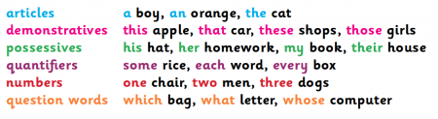
Determiners
What Do I Need To Know?
These are very specific:
the- The girl over there doesn’t look very well.
some- I bought some cheese from the store.
These are very general:
a- A girl came knocking on the front door.
an- An elephant ate the bananas.
this- I’d like to buy this car please.
those- Those shoes are perfect for the weekend.
Determiners are small words that go before nouns.
Articles can be definite (specific): the; or indefinite (general): a, an
Taster Questions:
YouTube Zone
Before
5
Developed by www.keystage2literacy.co.uk

Slide 17
Conjunctions
What Do I Need To Know?
Conjunctions join words or phrases together. They also join clauses in a sentence e.g.
‘It looked slimy, so I didn’t touch it.’
(Compound: Main Clause + Main Clause)
‘I stared silently, because it was singing.’
(Complex: Main Clause + Subordinate Clause)
‘Every day, the lion grew hungrier and hungrier.’
(Adverbial Phrase: Adverb Conj. + Main Clause)
There are a number of types of conjunction:
Coordinating conjunctions, subordinating conjunctions, correlative conjunctions
Examples:
Coordinating: for, and, nor, but, or, yet, so
(FANBOYS)
Subordinating: although, until, if, while, because, since, before, after
Correlative: both/and, either/or, neither/nor, whether/or, not only/but also
Taster Questions:
YouTube Zone
Before
22 & 23
Developed by www.keystage2literacy.co.uk

Slide 18
Prepositions
What Do I Need To Know?
Examples: in, on, at, to, into, of, from, for, by, before, after, until, than, over, under, above, below, between, among, up, down, inside, outside, behind, in front, since, until, during, against, about, around, round, like, unlike, except, with, without etc
Prepositions tell you where | Prepositions tell you when
Under, over, at, on, in, through, into I stuffed the sweets into my pocket. He jumped over the moon. | While, during, until, since, in, before, after I fell asleep during the football match. The soldiers marched until night fall.
Prepositions are often followed by a noun | Prepositions can follow prepositions
The cat hid under the table. The word ‘under’ is followed by the ‘table’ The knight rode on the white horse. The word ‘on’ is followed by a noun phrase. | Prepositions can show how a pronoun is related to something else. The house is behind you. The word ‘behind’ is followed by the pronoun ‘you.’ Nikki left after them.
Taster Questions:
YouTube Zone
Before
14 & 15
Developed by www.keystage2literacy.co.uk

Slide 19
Perfect Form of Verbs
What Do I Need To Know?
 | Past Perfect | Present Perfect | Future Perfect
I You We They He She It | had had had had had had had | have have have have has has has | will have will have will have will have will have will have will have
Examples:
I have completed the question that was set.
He has yet to complete his homework.
We had made a booking with the restaurant before we went.
She will have finished her work by break time.
The Present Perfect form is used to describe: past events, recent past events and unfinished states.
Taster Questions:
YouTube Zone
Before
N/A
Developed by www.keystage2literacy.co.uk

Slide 20
Synonyms & Antonyms
What Do I Need To Know?
Synonyms: mean the same thing. You need to have a wide enough vocabulary to be able to recognise or think of alternatives to every day or common words. Reading widely can help you.
Ensure you check that the synonym you use still makes sense in the sentence.
In the example, ‘The film was really sad,’ synonyms for sad might include tragic or upset. Which of these would be the best choice?
Antonyms: means the opposite. Once again, make sure that the antonyms you choose still make sense in the context that they are being used.
Suffixes can help to make antonyms too:
tune → tuneful and tuneless
Examples:
Modify this sentence using one of the antonyms:
‘They thought Merlin was an ordinary man.’
unique, peculiar, exceptional, unusual
Taster Questions:
YouTube Zone
Before
60 & 61
Developed by www.keystage2literacy.co.uk

Slide 21
Inverted Commas
What Do I Need To Know?
Remember:
With direct speech, it is important to place a comma before the inverted commas.
Place any punctuation inside the last set of inverted commas.
Alan explained, “You’ll need to learn all of this for the test.”
Inverted commas are also known as speech or quotation marks. They are used for direct speech.
Direct speech is when the author/writer records exactly what is said in the moment by the character.
Mr Hunter said, “Pencils down, that is the end of the test.”
Reported speech is when the author/writer records what was said previously but it does not have any inverted commas.
Mr Hunter told the children to put their pencils down at the end of the test.
Taster Questions:
YouTube Zone
Before
37
Developed by www.keystage2literacy.co.uk

Slide 22
Plural/Possessive ‘-s’
What Do I Need To Know?
For most plurals, we just add ‘s’ for example cat becomes cats and dog becomes dogs, but…
What happens with plurals that are possessive?
It is possible to have singular possessive (belonging to one person or thing) and plural possessive (belonging to more than one person or thing) nouns:
Singular possessive: the girl’s coat
In this example, the coat belongs to one girl.
Plural possessive: the girls’ coats
In this example, the coats belong to more than one girl. Did you also notice where the apostrophe went?
Examples:
(Do you notice the difference? What is the meaning in each of these?)
The animals were grazing in the field.
The animals’ homes were destroyed.
The animal’s lost its home.
Taster Questions:
YouTube Zone
Before
34 & 35
Developed by www.keystage2literacy.co.uk

Slide 23
Fronted Adverbials
What Do I Need To Know?
We used to call them ‘sentence openers’ or even subordinate clauses that come at the beginning.
A fronted adverbial is an adverbial phrase placed at the beginning of a sentence- it does not have to make sense on its own, therefore is not the main clause, it is a dependent clause.
In the sentence…
Mario ate his pasta as quickly as he could.
…the adverbial phrase can be moved to the front:
As quickly as he could, Mario ate his pasta.
Notice how a comma follows the fronted adverbial.
Examples:
Whilst he was sleeping, Darren’s house was burgled.
Having won the race, Zeffie collected her medal.
As soon as he got home, Rhys got changed and played on his Xbox.
Taster Questions:
YouTube Zone
Before
12 & 23
Developed by www.keystage2literacy.co.uk

Slide 24
Verb Inflections
What Do I Need To Know?
Also known as Inflectional Endings: a group of letters added to the end of a word to change their meaning. –s, -es, -ing, -ed
The verb can change according to the spelling as well, such as ‘take’ becomes ‘taking’ by removing ‘e’ first before adding ‘ing.’
walk - walked – walking
mix – mixes – mixed – mixing
Sometimes the consonant at the end of a word is doubled to allow for the inflectional ending:
hop – hopping - hopped
Examples:
s: horse → horses
es: watch → watches
ies: hurry → hurries
d: rate → rated
ed: heed → heeded
ied: worry → worried
ing: know → knowing
ing: slam → slamming
ly: steep → steeply
ily: happy → happily
Taster Questions:
YouTube Zone
Before
N/A
Developed by www.keystage2literacy.co.uk

Slide 25

Modal Verbs
What Do I Need To Know?
Modal verbs show how likely something is to happen.
This Shades Metre shows you how likely something is to happen on a scale of importance: ‘dare’ being the most urgent or important and ‘shall’ being the least important.
Should is a strong suggestion that you should do something, but still leaves an element of choice.
Must is a very strong suggestion and you are likely to listen.
Shall is weak- you might not bother.
Examples:
Can- I can speak English.
Could- She could go out.
May- It may rain today.
Might- It might snow.
Must- You must sit down.
Should- They should ask.
Will- He will ask her.
Would- He would like to.
Taster Questions:
YouTube Zone
Before
8
Developed by www.keystage2literacy.co.uk

Slide 26
Cohesive Devices
What Do I Need To Know?
Cohesive devices are useful conjunctions, transitional phrases, synonyms and pronouns that express ideas in a cohesive manner.
They are used to join sentences together to make ideas more understandable to the reader.
Cohesive devices or cohesion use linking words or phrases for a vast range of reasons:
To list (first, second, next, to begin), for reinforcement (also, furthermore, in addition), similarity (equally, likewise), transition to a new point (as for…, now, turning to), summary (in conclusion, therefore), to give an example (for instance, in this case), and so on…
Examples: cohesive devices act like conjunctions and can be placed at the beginning or middle of a sentence.
Remember: pronouns are useful cohesive devices as they prevent us from repeating someone’s name. The ellipsis … is also a cohesive device.
Taster Questions:
YouTube Zone
Before
N/A
Developed by www.keystage2literacy.co.uk

Slide 27
Verb Prefixes
What Do I Need To Know?
Verb prefixes are simply that… verbs with a prefix at the beginning of them. The prefixes often change the meaning of the verb, for example:
patient → impatient
like → dislike
lock → unlock
appear → disappear
write → rewrite
Remember that we are looking for prefixes for verbs (doing words) rather than just any word e.g. legal → illegal (these are adjectives)
Examples:
Prefixes have meanings-
un-/dis-: opposite of
re-: again
in-/im-/ir-/il-/non: not
en-: cause to
under-: too little
in-/im-: (in or into)
Taster Questions:
YouTube Zone
Before
N/A
Developed by www.keystage2literacy.co.uk

Slide 28
Parenthesis
What Do I Need To Know?
Parenthesis is just a big word for something else that you’ve been doing all along: brackets!
Brackets or parenthesis are used to separate extra information. Sometimes you can use commas to do this as well- as you would when you place a subordinate clauses in a sentence.
Remember that when you remove the brackets and the information between them, the rest of the sentence still makes sense.
The information in the brackets doesn’t have to be a complete sentence. E.g. The farmer (who lived in Devon) frantically searched his fields for his sheep.
Examples:
Zoe couldn’t find her friends (they were in the bathroom).
Charlie (a schoolboy) often decided to cycle to school.
Abigail enjoyed running for her school (she won a lot of medals).
Taster Questions:
YouTube Zone
Before
41
Developed by www.keystage2literacy.co.uk

Slide 29
Relative Clauses
What Do I Need To Know?
A relative clause is a type of subordinate clause. It gives extra information to the main clause.
Remember that the main clause is a strong, independent clause that makes sense on its own.
The relative clause doesn’t have to make sense on its own (it is a dependent clause.)
Relative clauses have their own relative pronouns as well: who, which, whose, that
Bob was a truck driver who travelled many miles.
Main clause + relative pronoun + relative clause
Examples:
I normally eat the sandwich which has the most filling in.
Beatrice was an annoying cat that scratched at the furniture all of the time.
We became good friends with Arnold whose lottery numbers had recently come up!
Taster Questions:
YouTube Zone
Before
21
Developed by www.keystage2literacy.co.uk

Slide 30
Noun Phrases
What Do I Need To Know?
A noun phrase is a group of words which includes a noun and any words that describe it. It sounds a lot more complicated than it really is. Let’s have a look at some examples:
Hannah ran away from the hideous, frightening monster.
The noun phrase contains the monster and the words that describe it: hideous and frightening.
Roaring loudly, the lion frightened the small, scared children.
The noun phrase contains the children and the words that describe it: small and scared.
Examples:
You can add adjectives, prepositions or other nouns to expand a noun phrase.
Hannah ran away from the hideous, frightening monster with green eyes.
Taster Questions:
YouTube Zone
Before
10
Developed by www.keystage2literacy.co.uk

Slide 31
Subjunctive Form
What Do I Need To Know?
Subjunctive form might be used in a formal text. When a sentence is talking about something important or urgent, it would use the subjunctive form.
She must make sure she buys a cat. →
It is essential that she buy a cat.
The subjunctive form might also be used if you are talking about a situation that isn’t real:
If I was a good waiter, I’d never drop anything. →
If I were a good waiter, I would never drop anything.
Examples:
It is important that we are quiet. → It is essential that we be quiet.
Video: Listen to the songs in the video:
If I was…
If I were…
Which are subjunctive and which are not?
Taster Questions:
YouTube Zone
Before
27
Developed by www.keystage2literacy.co.uk

Slide 32
Formal and Informal
What Do I Need To Know?
In different text types or genres you may be able to spot the difference between formal and informal language being used by the author.
Formal writing uses more complicated words (as well as the Subjunctive Form which we learnt about in the previous unit)
Informal writing sometimes uses question tags as well as contractions such as ‘didn’t and won’t’
Formal: I asked for the salad → I requested the salad.
Informal: You’re coming later, aren’t you?
Contractions Question Tags
You’ll know ‘im when you see ‘im!
I’m sure you aint got nothing to worry about.
I’m not bothered, are you?
I’d rather be watching the races instead of the football.
She’ll be asking you to tea later on today.
Taster Questions:
YouTube Zone
Before
27
Developed by www.keystage2literacy.co.uk

Slide 33
Passive and Active Voice
What Do I Need To Know?
It is important that you know the difference between the two of these.
Active Voice tells you that the subject of the sentence (the WHO) is doing an action to an object.
Alexis jumped over the hurdle.
Subject + verb + preposition + object
In this sentence it is clear that Alexis is doing something. The subject is Active.
Passive Voice tells you that something (the WHAT) is being done to the subject.
The hurdle was jumped over by Alexis.
Examples:
In Passive, you don’t always need to say who does the action.
The cake mixture was poured. (Here, the object is BEFORE the verb.)
Jim poured the cake mixture. (In Active, you need a subject. The object is AFTER the verb.)
Taster Questions:
YouTube Zone
Before
9
Developed by www.keystage2literacy.co.uk

Slide 34
Colons and Semi Colons
What Do I Need To Know?
Colons | Semi-Colons
Can introduce a list To make a cake, you will need: 2 eggs, etc. Only use a colon if it follows a main clause. Go before bullet points Today’s meeting agenda: Volunteers for the fair Stall holders etc. Introduce explanations: Main Idea + More Detail I’d like to buy an ice-cream: probably strawberry flavour. | Break up lists (of longer phrases or clauses) When I go camping we will be building a campfire; putting up our tents in the dark; cooking yummy marshmallows, and fishing by the lake. Break up clauses Sally was ready for bed; Aaron wanted to keep playing. (Both sides are equally important)
The mouse was playing: the cat was asleep.
Here it seems as though the mouse was playing because the cat was asleep.
The mouse was playing; the cat was asleep.
Here we just have two statements of equal importance.
Taster Questions:
YouTube Zone
Before
42 - 45
Developed by www.keystage2literacy.co.uk

Slide 35
Elision
What Do I Need To Know?
Elision is the omission of a sound or syllable when speaking.
Elision is the shortening of words. The letters that are often the first to go are the vowels. Have a look at the examples below to see what has happened to these.
lovely → lov’ly
kind of → kinda
sort of → sorta
interest → int’rest
library → lib’ry
Examples:
different → diff’rent
tonight → t’night
I didn’t bother waiting for him →
I din’t bother waitin’ for ‘im.
Taster Questions:
YouTube Zone
Before
N/A
Developed by www.keystage2literacy.co.uk

Slide 36
Hyphens (& Dashes)
What Do I Need To Know?
A hyphen… slightly different to the dash.
Dashes working in a similar way to brackets in that they are there to add extra information.
A pair of dashes are much like the brackets. The extra information goes between them.
The girls – Jess and Charlotte – played outside.
A single dash can mark a pause in a sentence. It usually separates two main clauses.
Sofia was plunged into the water – Danielle clung on to the rocks above with all her might!
A hyphen can be used to join two words together such as: over-excited; middle-aged
Examples:
Mary – an acrobat by night – set off to the supermarket for some fruit.
Mary nearly slipped as she looked down – there was a loud gasp from the audience below!
Taster Questions:
YouTube Zone
Before
41
Developed by www.keystage2literacy.co.uk

Slide 37
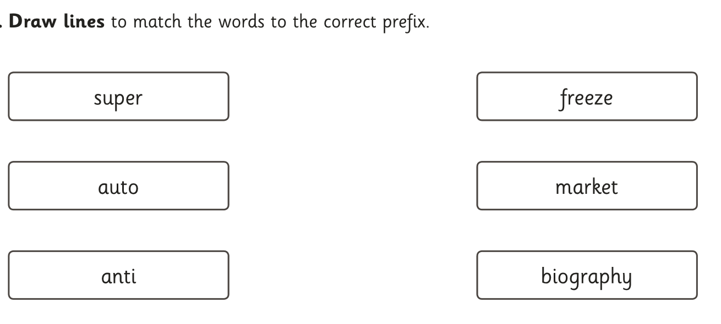
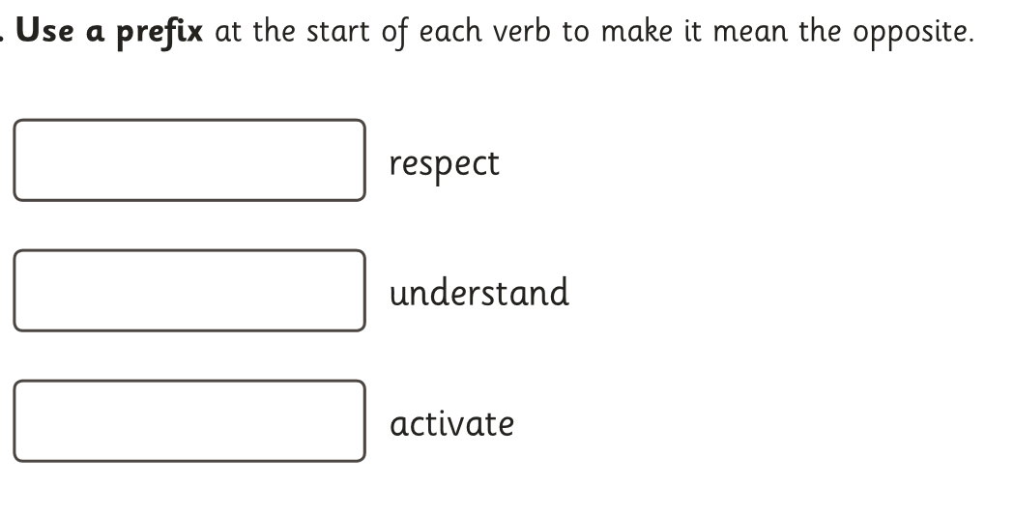
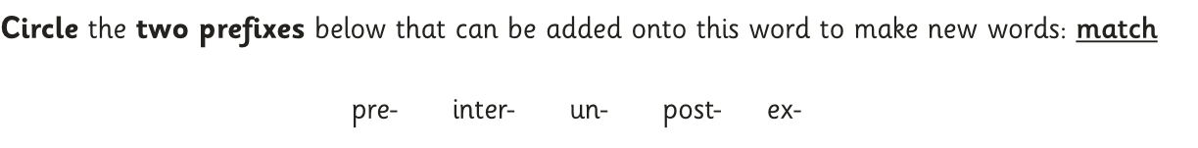
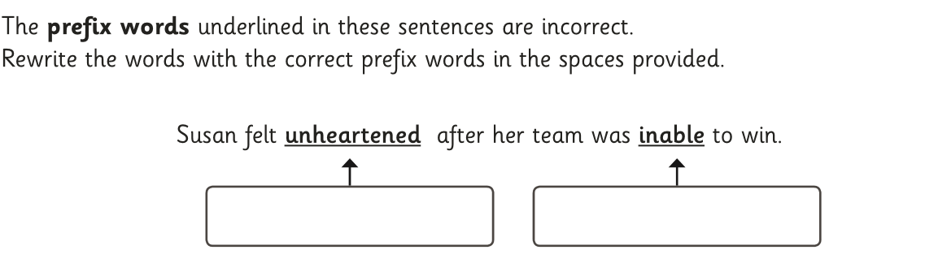
Prefixes
Click to go back…
What Do I Already Know?
Try these SPaG Test questions out independently…
Developed by www.keystage2literacy.co.uk

Slide 38
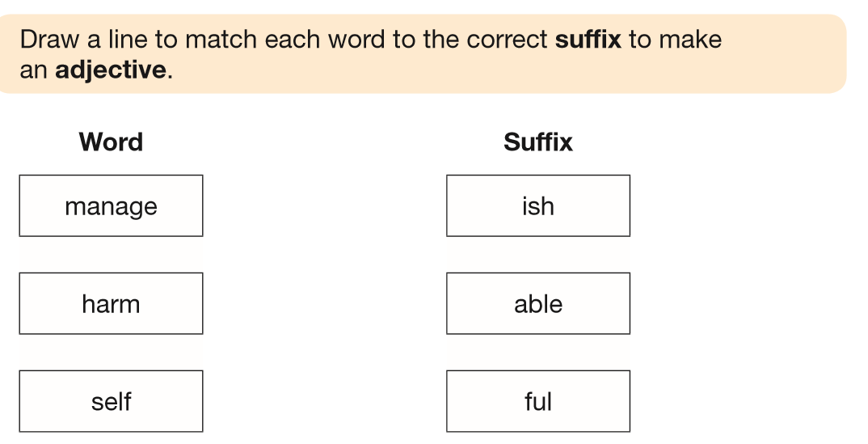
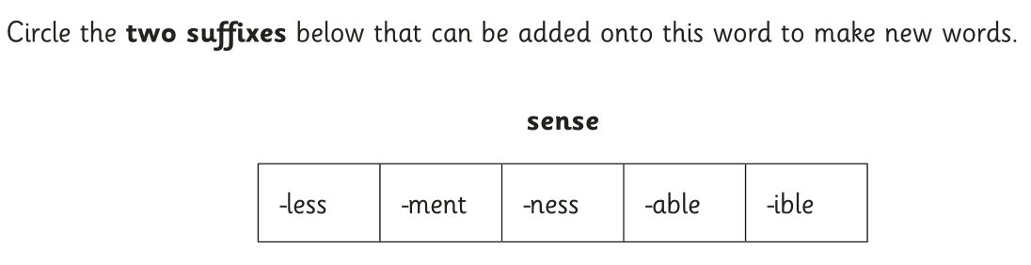
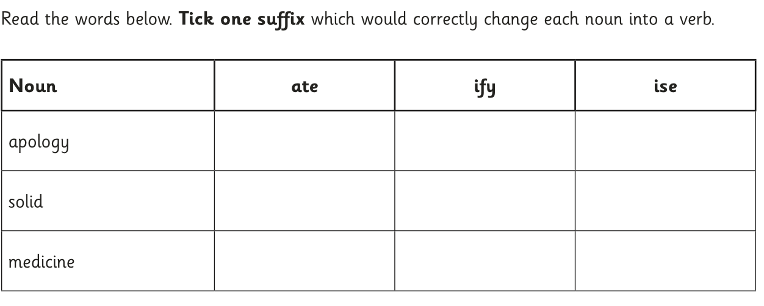
Suffixes
Click to go back…
What Do I Already Know?
Try these SPaG Test questions out independently…
Developed by www.keystage2literacy.co.uk

Slide 39
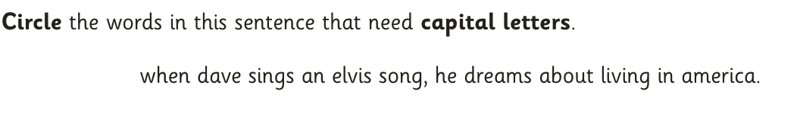
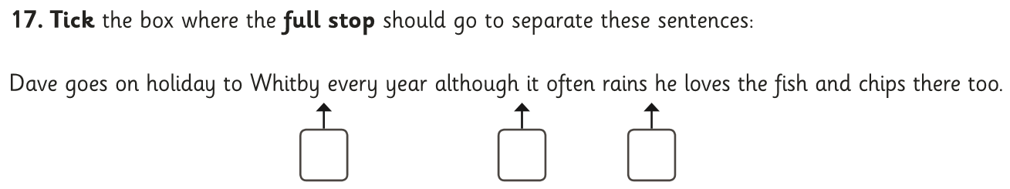
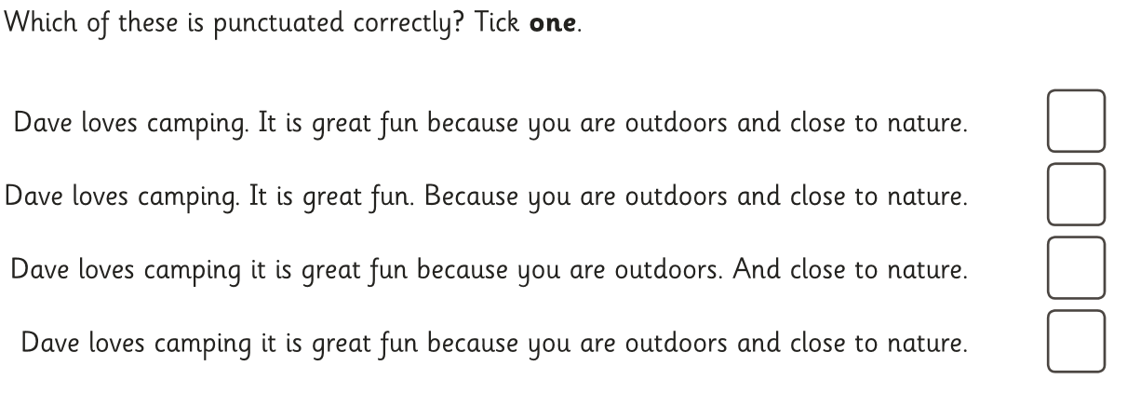
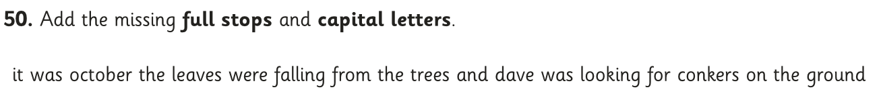
Capital Letters and Full Stops
Click to go back…
What Do I Already Know?
Try these SPaG Test questions out independently…
Developed by www.keystage2literacy.co.uk

Slide 40
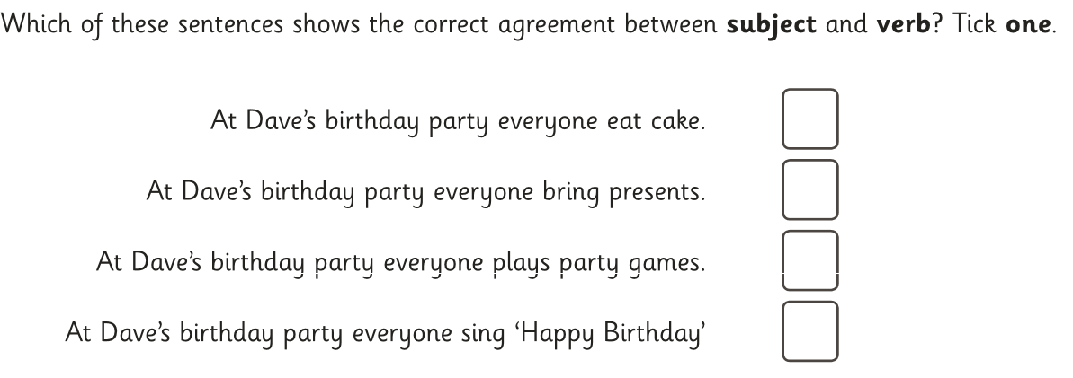
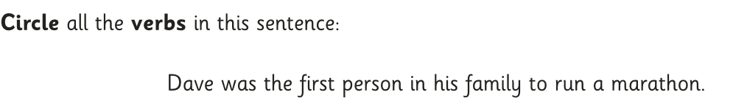
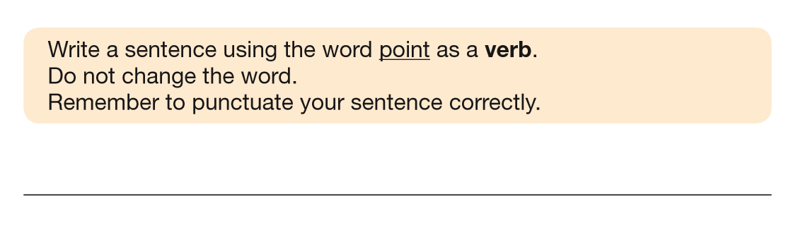
Verbs
Click to go back…
What Do I Already Know?
Try these SPaG Test questions out independently…
Developed by www.keystage2literacy.co.uk

Slide 41
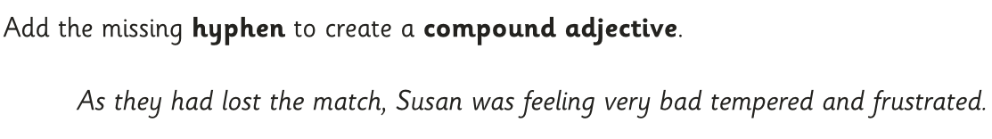
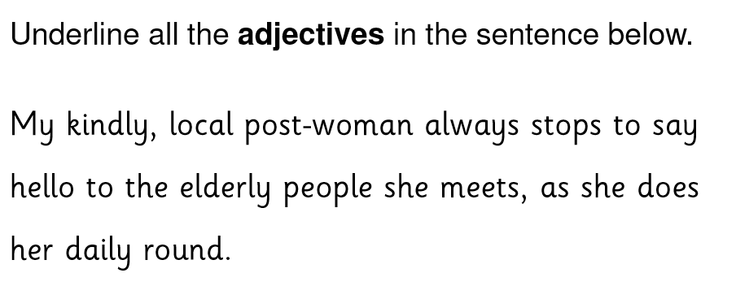
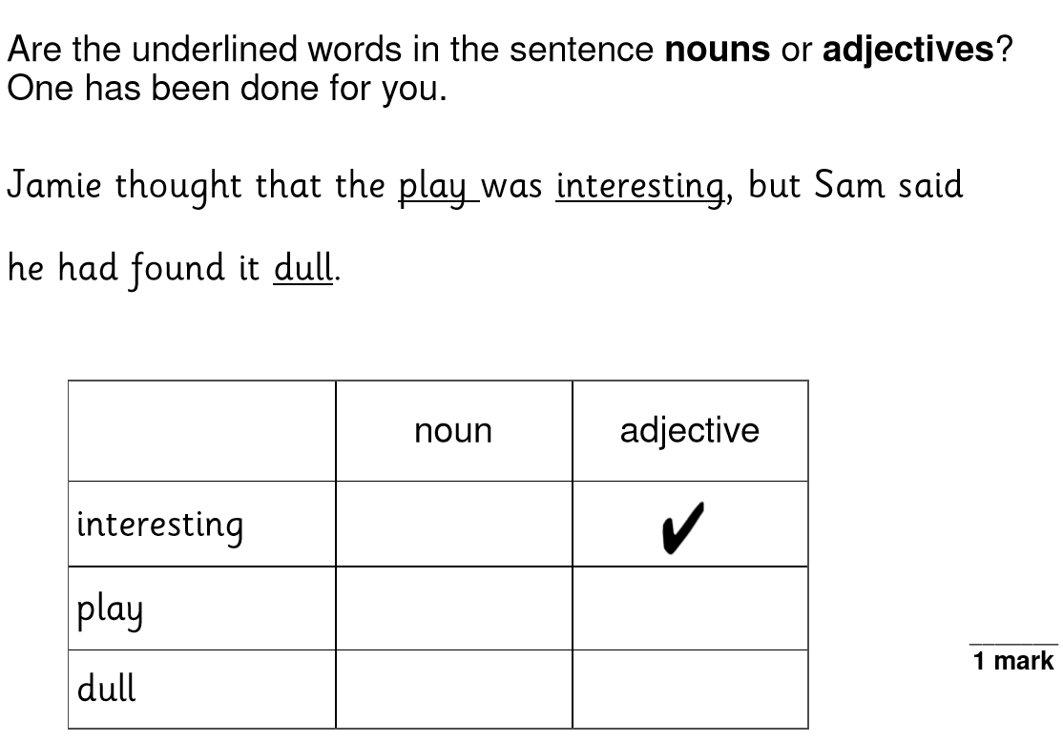
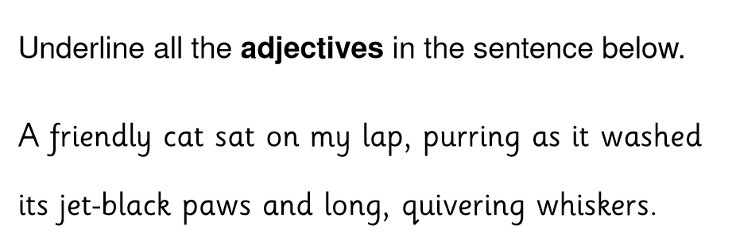
Adjectives
Click to go back…
What Do I Already Know?
Try these SPaG Test questions out independently…
Developed by www.keystage2literacy.co.uk

Slide 42
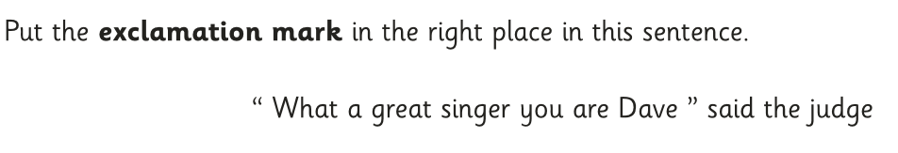
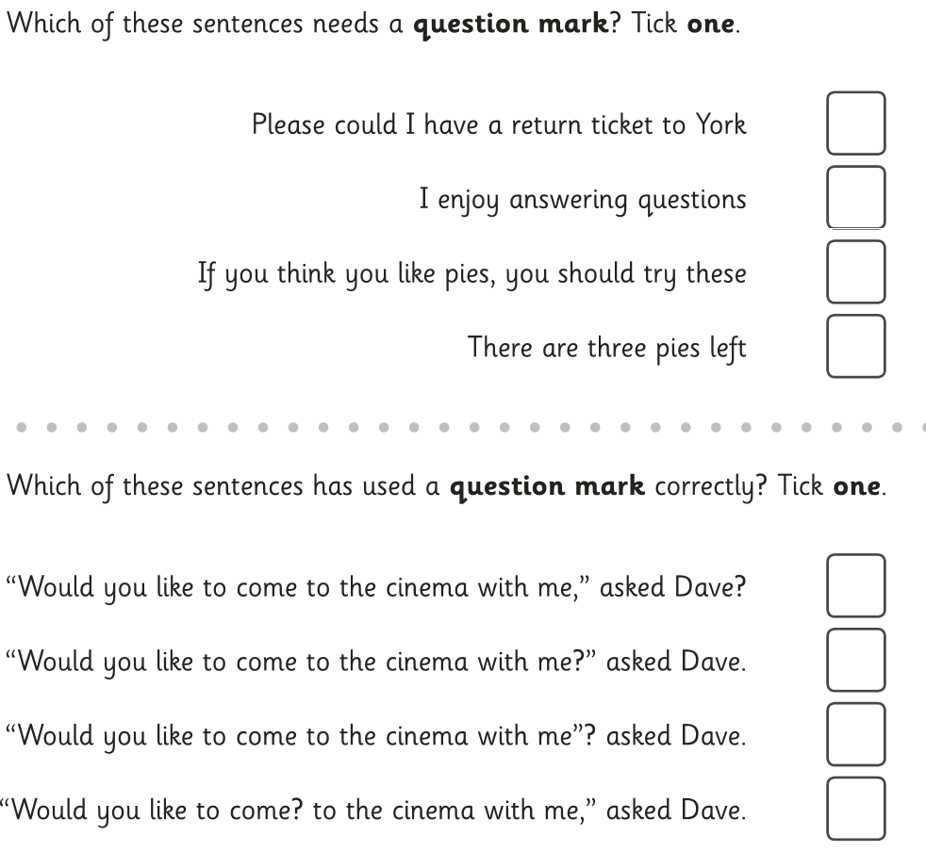
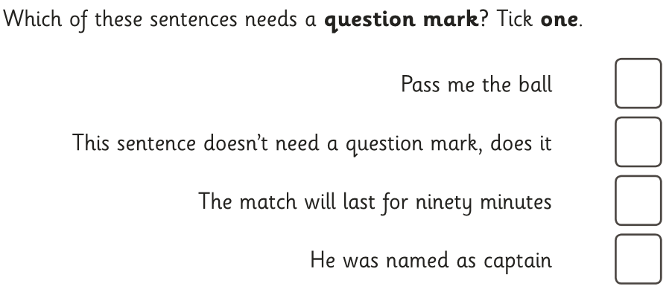
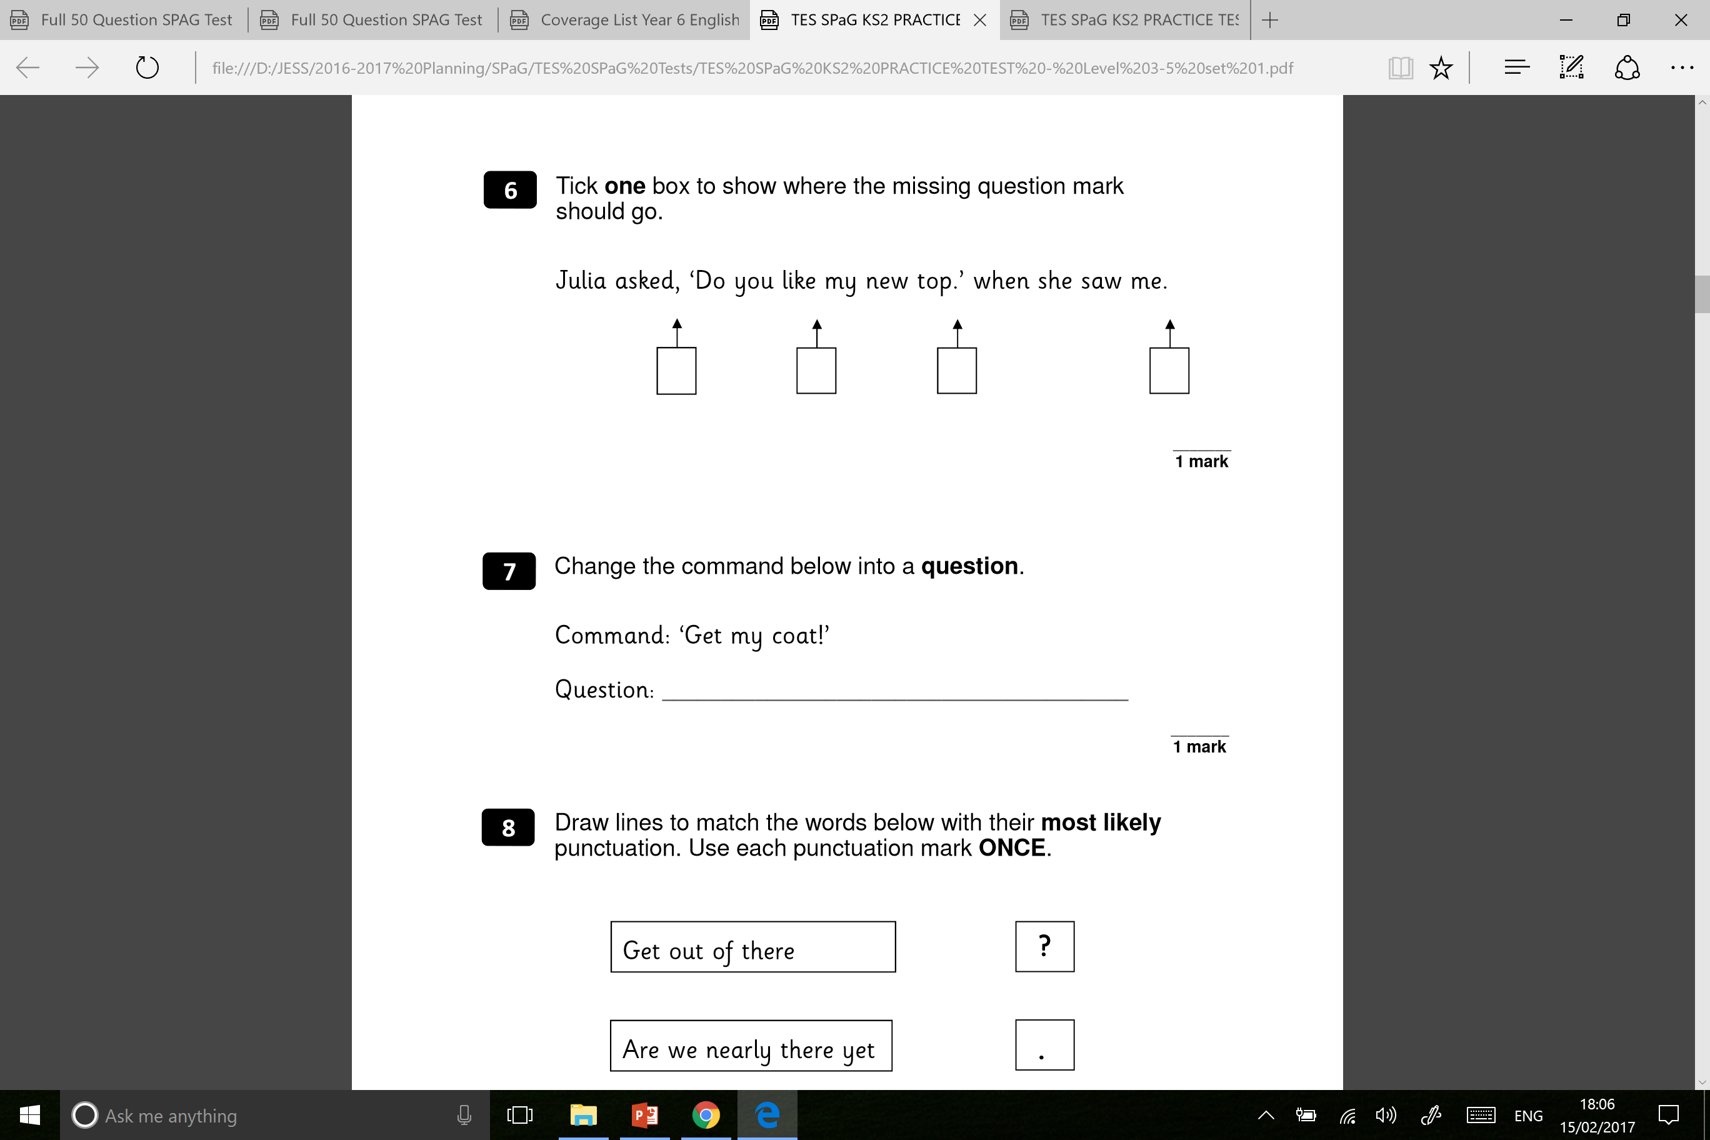
Question & Exclamation Marks
Click to go back…
What Do I Already Know?
Try these SPaG Test questions out independently…
Developed by www.keystage2literacy.co.uk

Slide 43
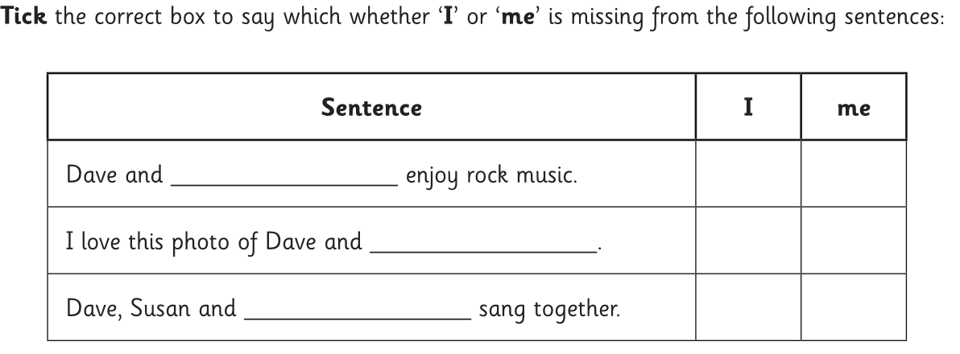
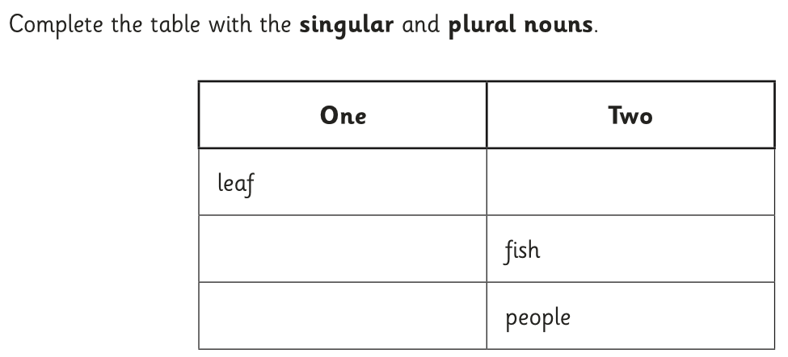
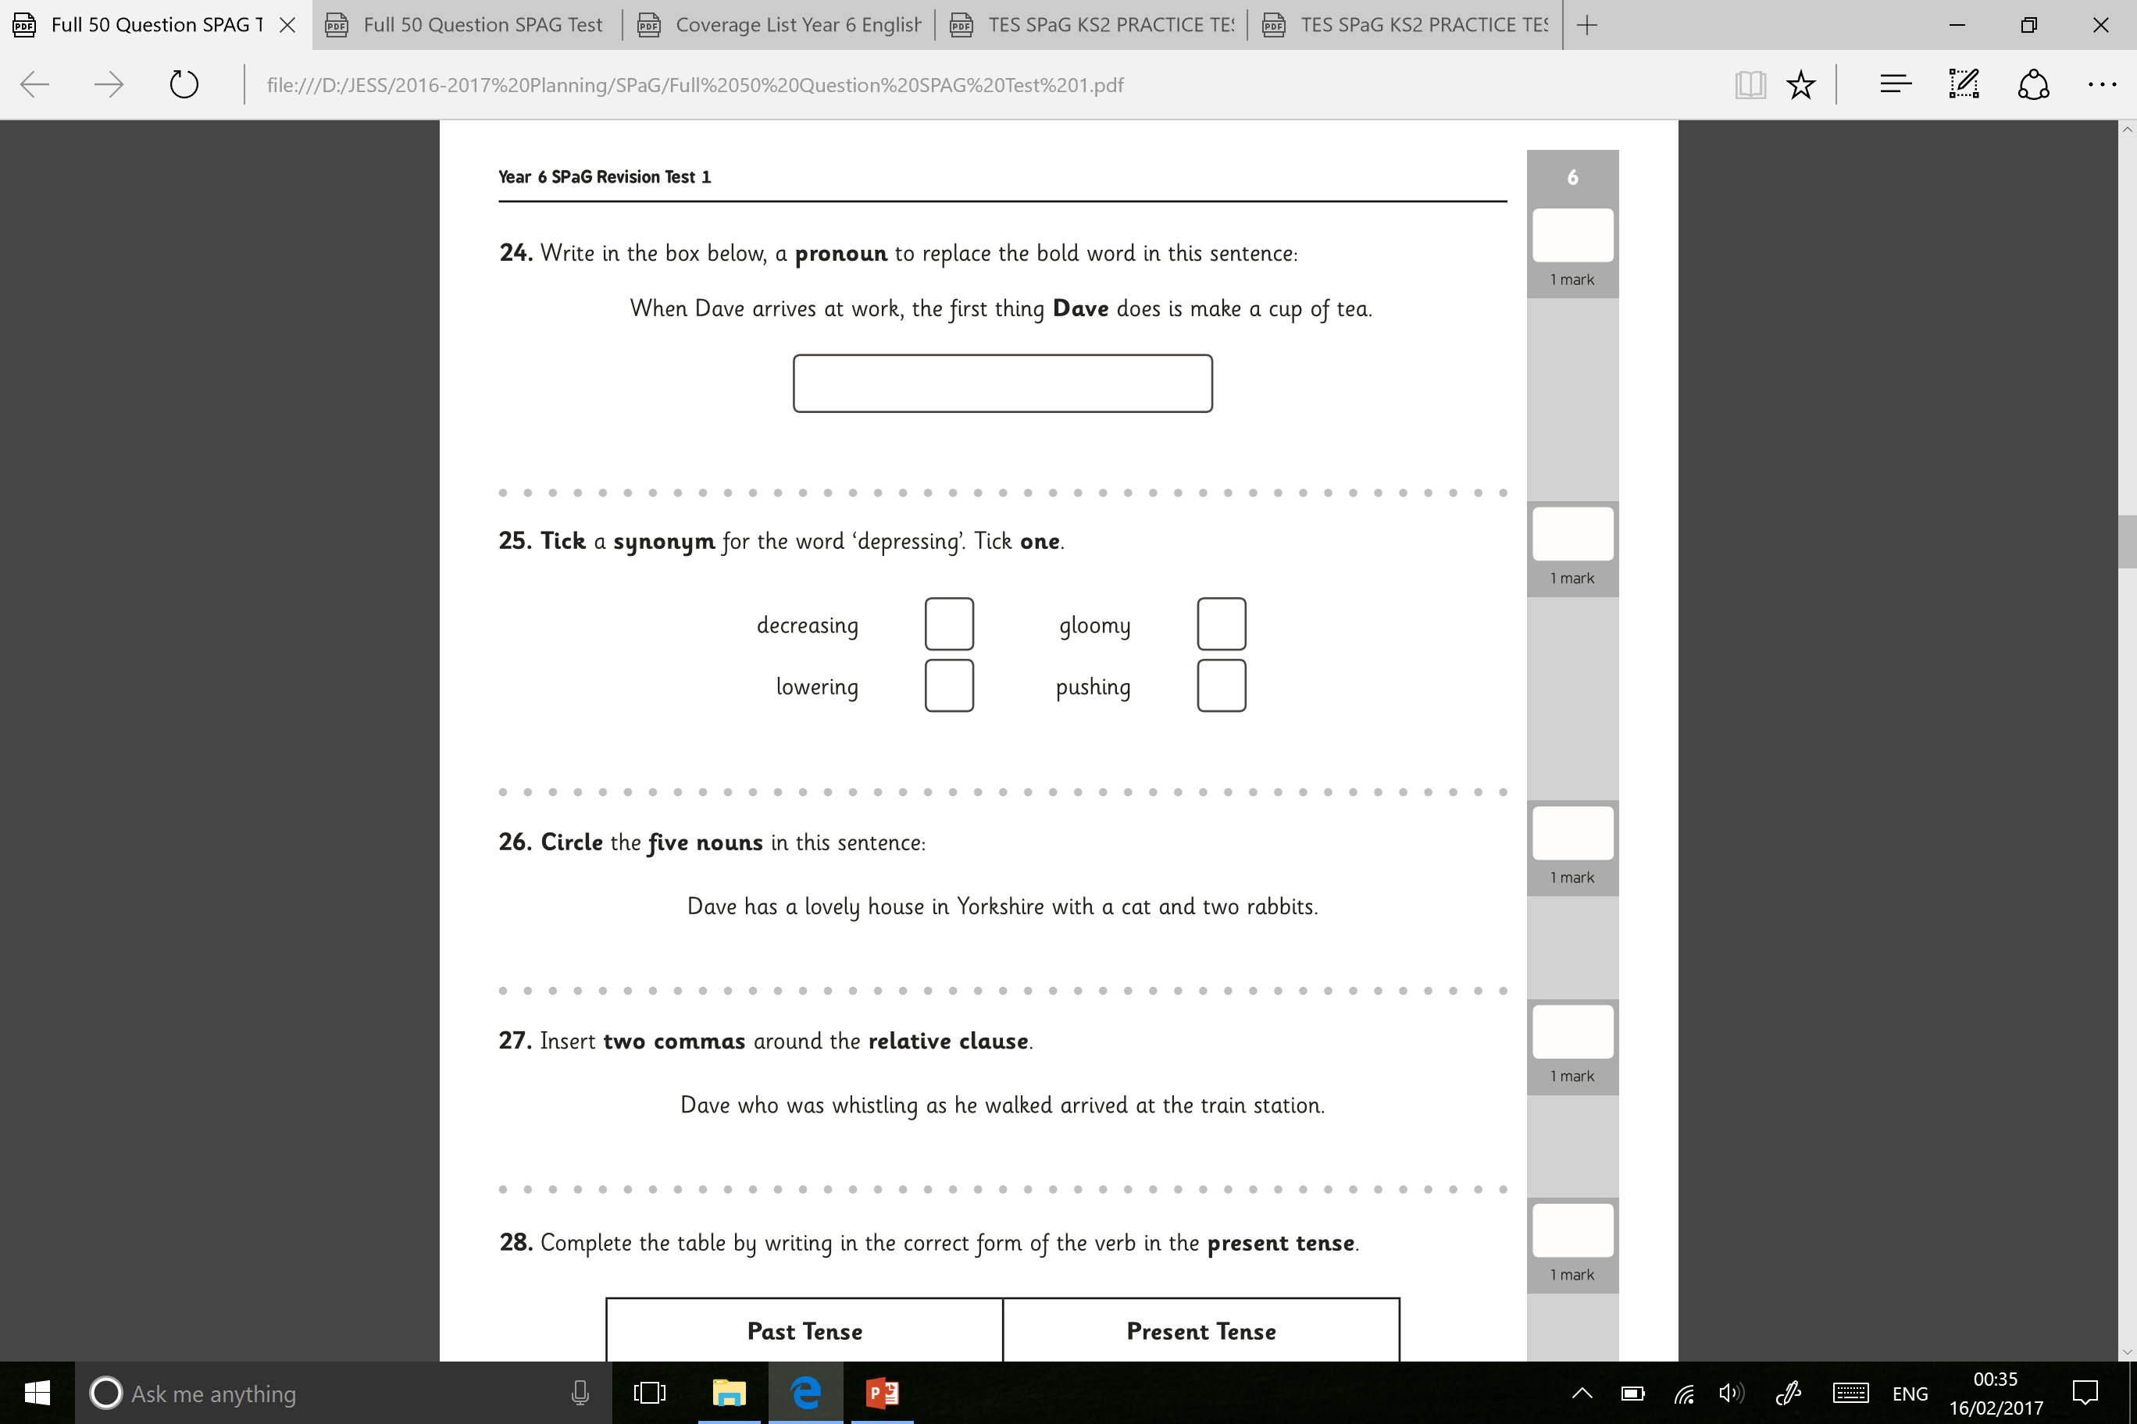
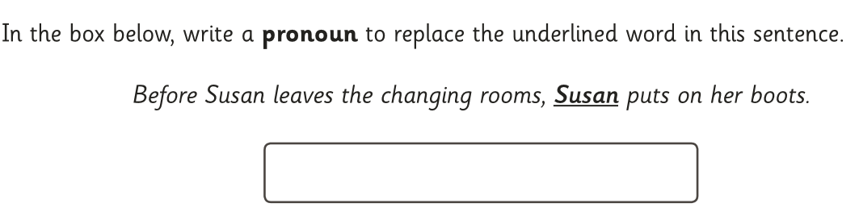
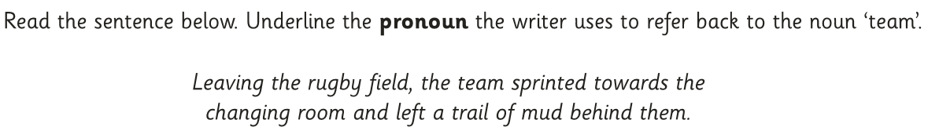
Nouns & Pronouns
Click to go back…
What Do I Already Know?
Try these SPaG Test questions out independently…
Developed by www.keystage2literacy.co.uk

Slide 44
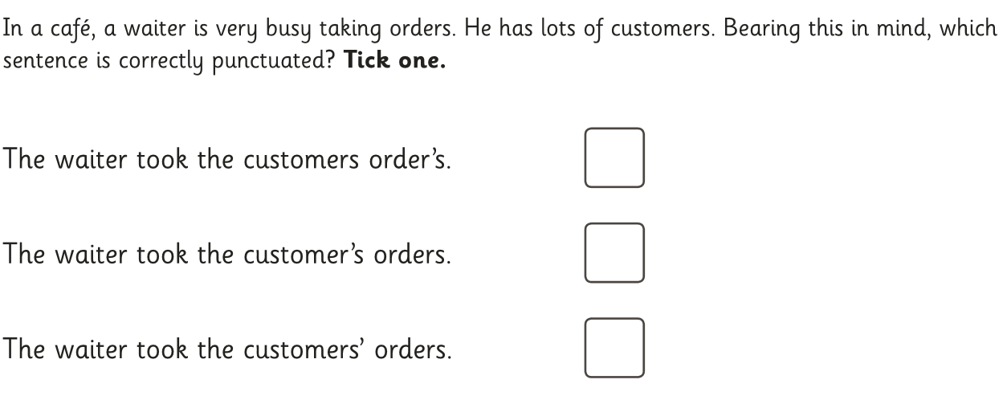
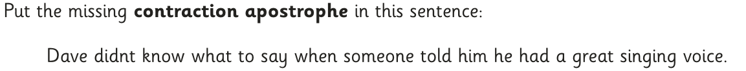
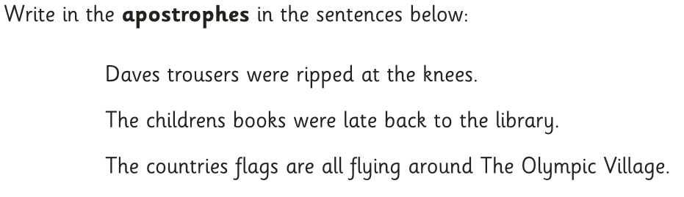
Apostrophes
Click to go back…
What Do I Already Know?
Try these SPaG Test questions out independently…
Developed by www.keystage2literacy.co.uk

Slide 45
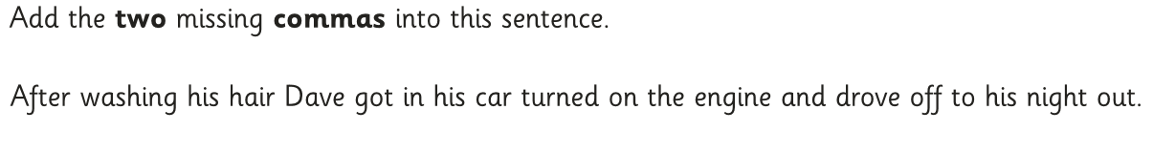
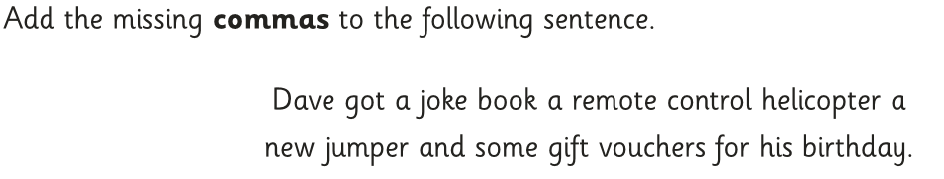
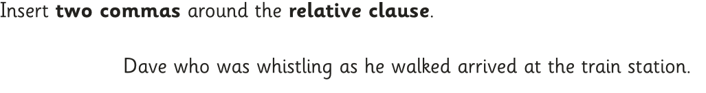
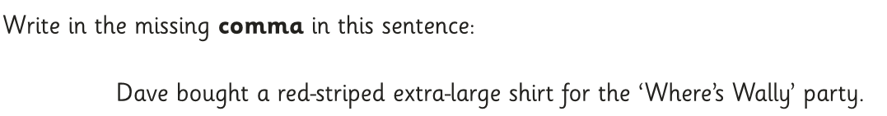
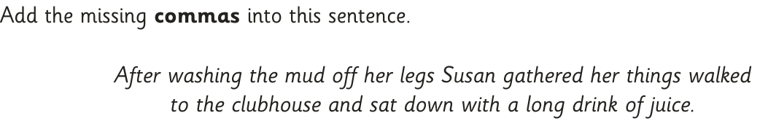
Commas
Click to go back…
What Do I Already Know?
Try these SPaG Test questions out independently…
Developed by www.keystage2literacy.co.uk

Slide 46
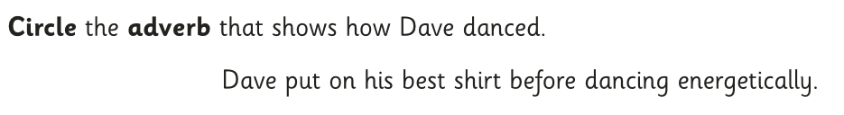
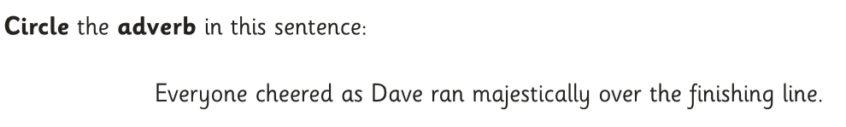
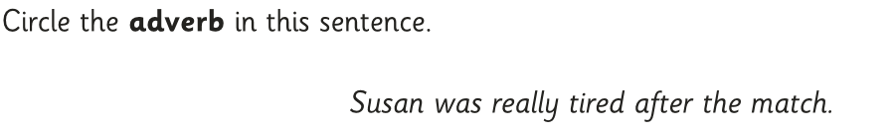
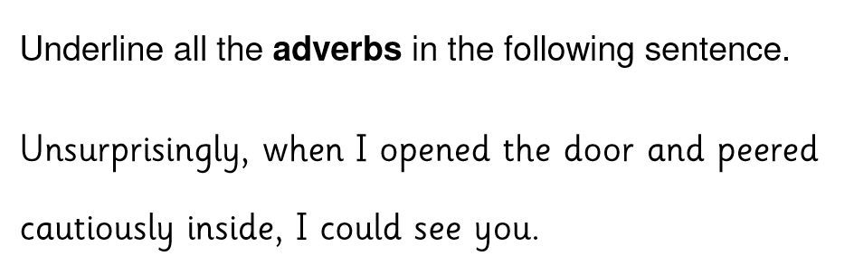
Adverbs
Click to go back…
What Do I Already Know?
Try these SPaG Test questions out independently…
Developed by www.keystage2literacy.co.uk

Slide 47
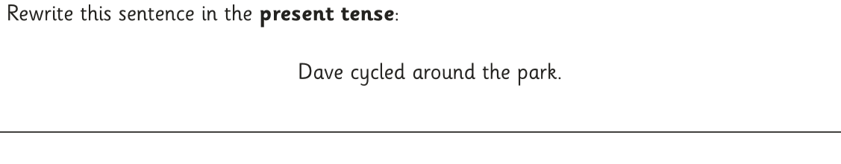
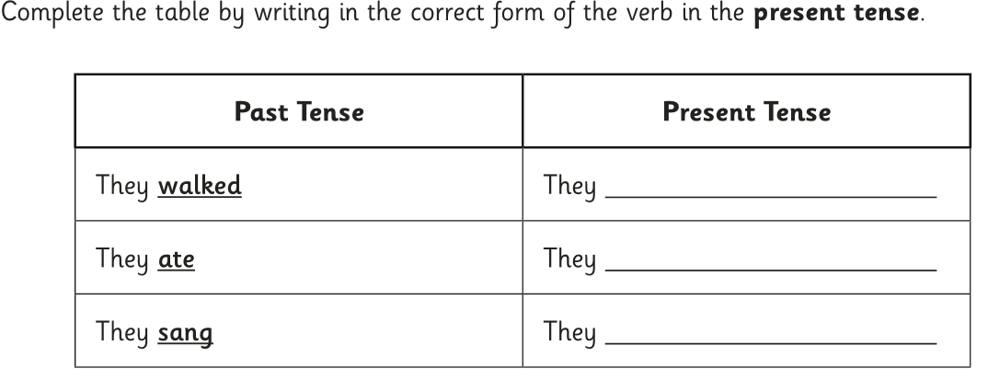
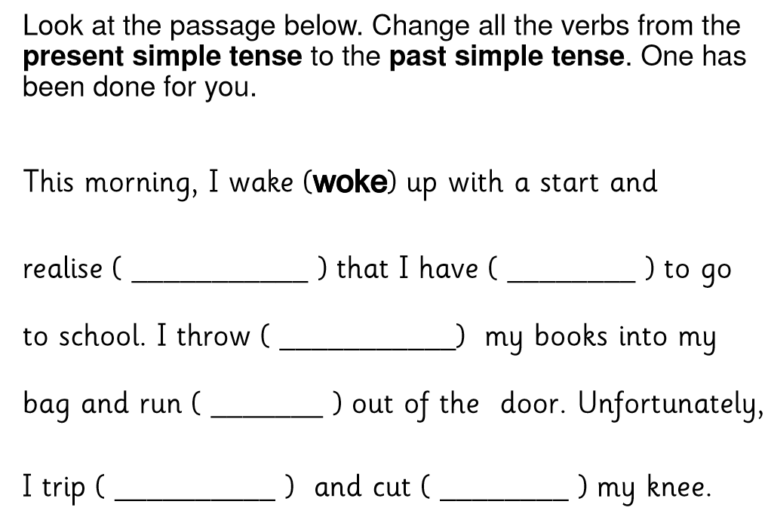
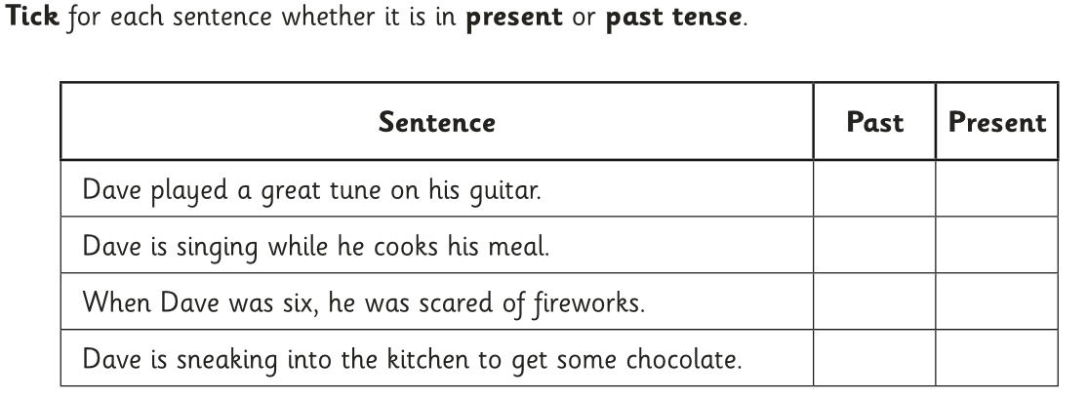
Present & Past Tense
Click to go back…
What Do I Already Know?
Try these SPaG Test questions out independently…
Developed by www.keystage2literacy.co.uk

Slide 48
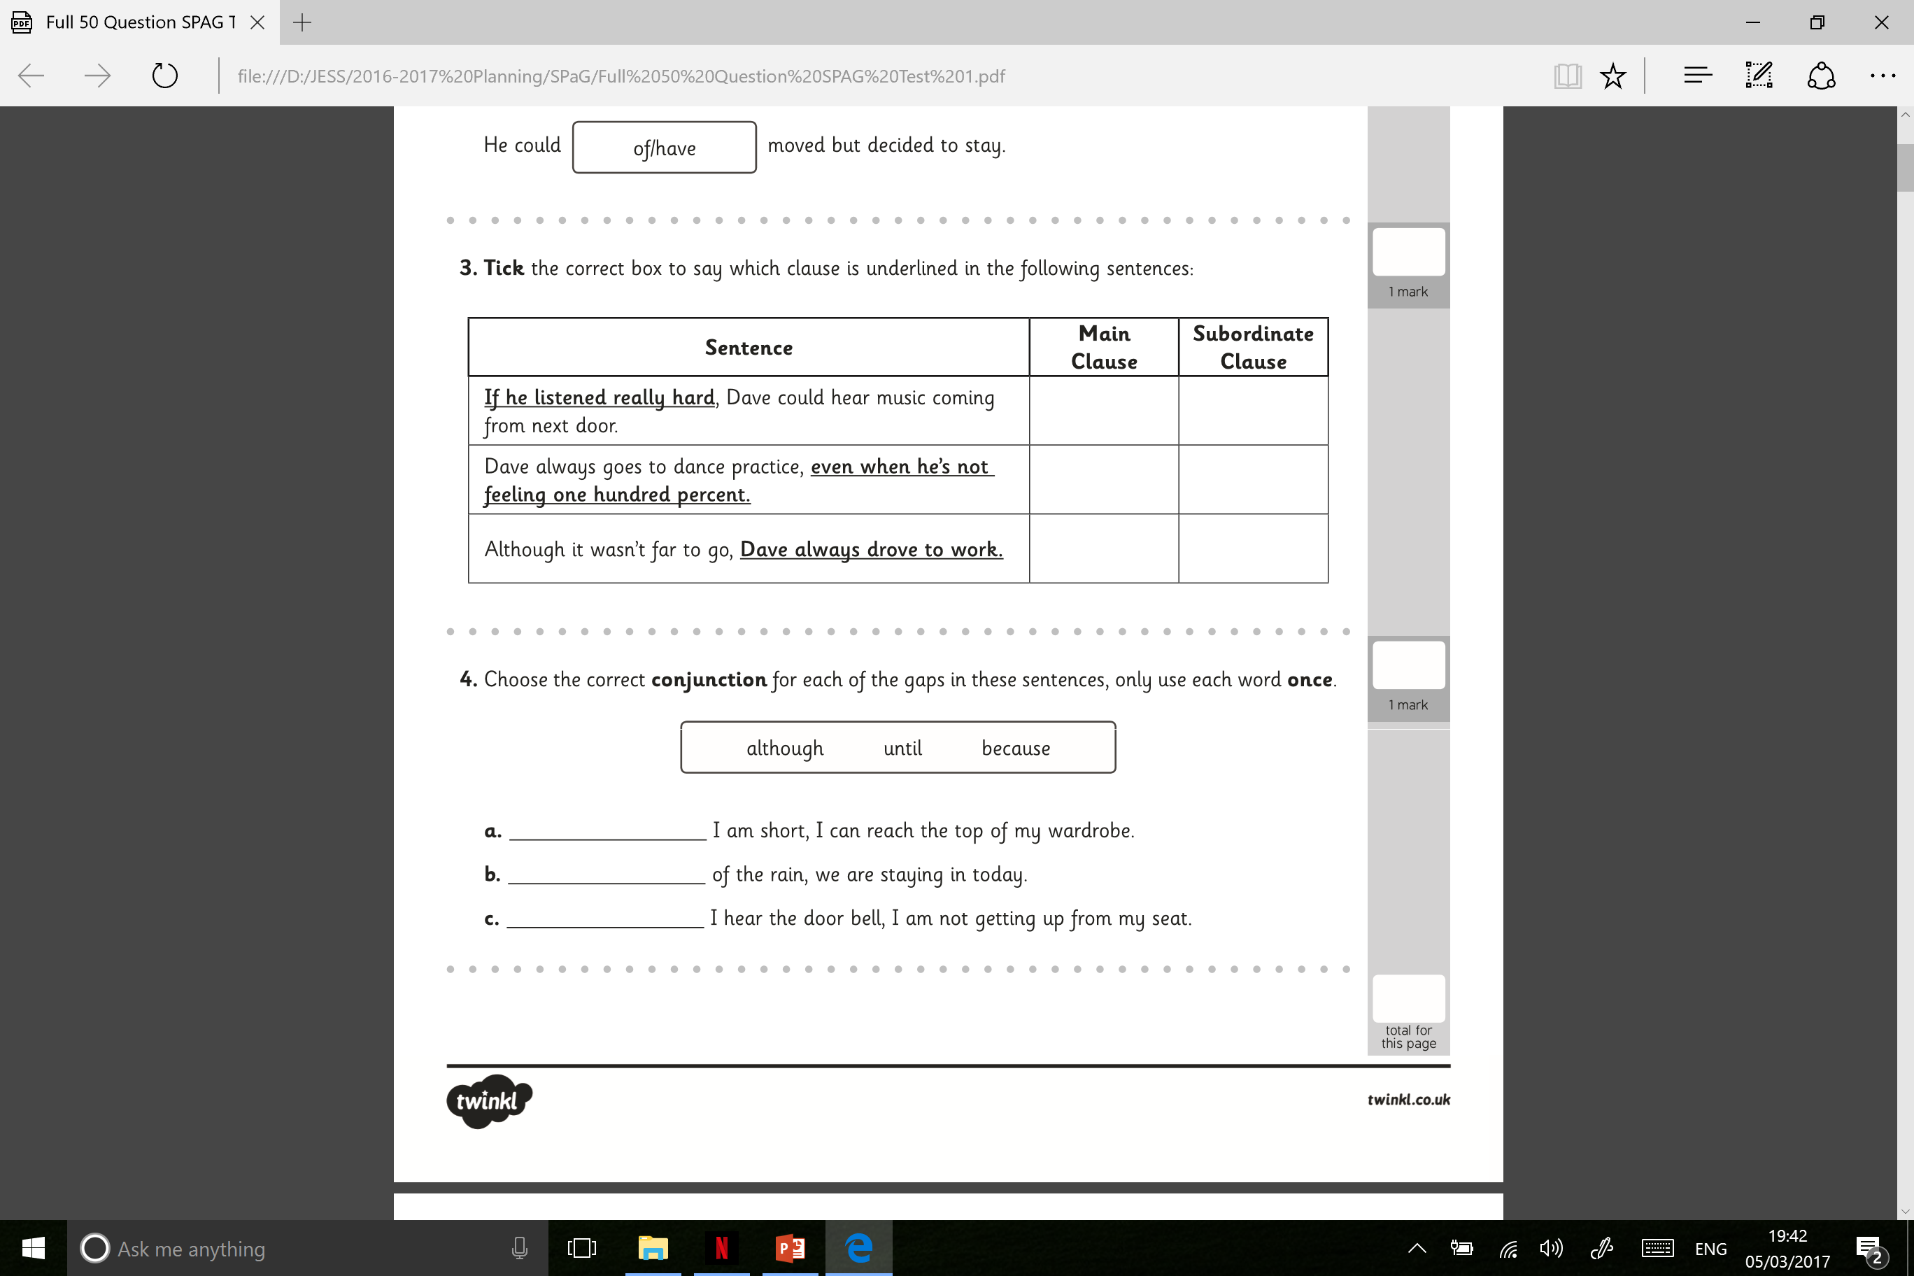
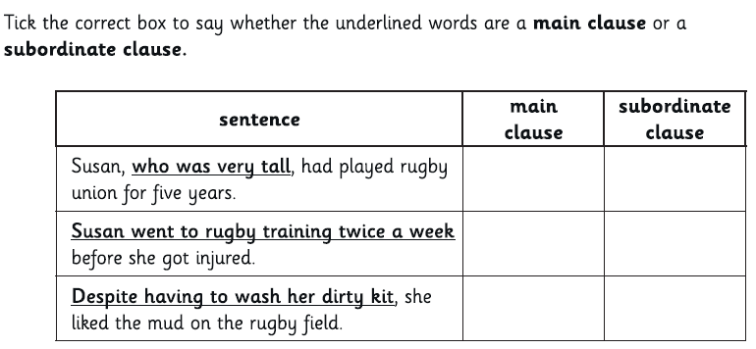
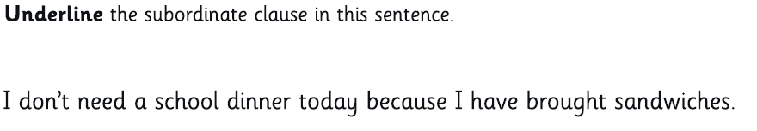
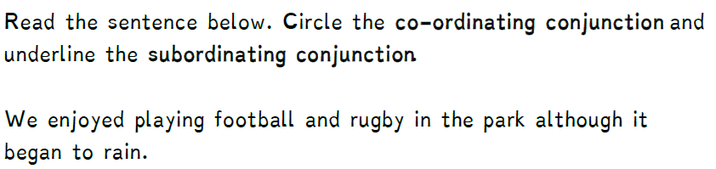
Subordination/Coordination
Click to go back…
What Do I Already Know?
Try these SPaG Test questions out independently…
Developed by www.keystage2literacy.co.uk

Slide 49
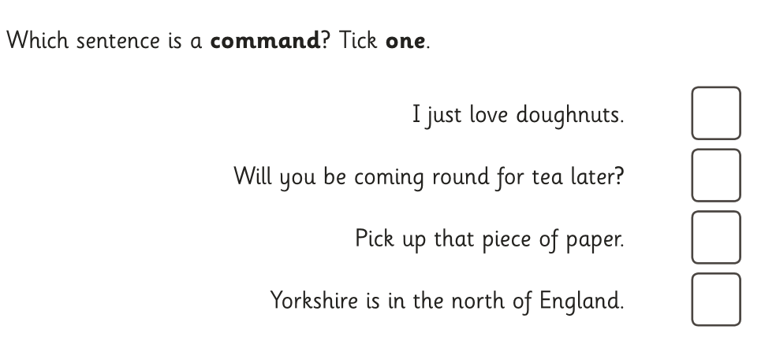




Commands & Statements
Click to go back…
What Do I Already Know?
Try these SPaG Test questions out independently…
Developed by www.keystage2literacy.co.uk

Slide 50

Continuous Form of Verbs
Click to go back…
What Do I Already Know?
Try these SPaG Test questions out independently…
Developed by www.keystage2literacy.co.uk

Slide 51




Determiners
Click to go back…
What Do I Already Know?
Try these SPaG Test questions out independently…
Developed by www.keystage2literacy.co.uk

Slide 52




Conjunctions
Click to go back…
What Do I Already Know?
Try these SPaG Test questions out independently…
Developed by www.keystage2literacy.co.uk

Slide 53




Prepositions
Click to go back…
What Do I Already Know?
Try these SPaG Test questions out independently…
Developed by www.keystage2literacy.co.uk

Slide 54




Perfect Form of Verbs
Click to go back…
What Do I Already Know?
Try these SPaG Test questions out independently…
Developed by www.keystage2literacy.co.uk

Slide 55





Synonyms & Antonyms
Click to go back…
What Do I Already Know?
Try these SPaG Test questions out independently…
Developed by www.keystage2literacy.co.uk

Slide 56



Inverted Commas
Click to go back…
What Do I Already Know?
Try these SPaG Test questions out independently…
Developed by www.keystage2literacy.co.uk

Slide 57


Plural/Possessive ‘-s’
Click to go back…
What Do I Already Know?
Try these SPaG Test questions out independently…
Developed by www.keystage2literacy.co.uk

Slide 58



Fronted Adverbials
Click to go back…
What Do I Already Know?
Try these SPaG Test questions out independently…
Developed by www.keystage2literacy.co.uk

Slide 59




Verb Inflections
Click to go back…
What Do I Already Know?
Try these SPaG Test questions out independently…
Developed by www.keystage2literacy.co.uk

Slide 60



Modal Verbs
Click to go back…
What Do I Already Know?
Try these SPaG Test questions out independently…
Developed by www.keystage2literacy.co.uk

Slide 61




Cohesive Devices
Click to go back…
What Do I Already Know?
Try these SPaG Test questions out independently…
Developed by www.keystage2literacy.co.uk

Slide 62




Verb Prefixes
Click to go back…
What Do I Already Know?
Try these SPaG Test questions out independently…
Developed by www.keystage2literacy.co.uk

Slide 63



Parenthesis
Click to go back…
What Do I Already Know?
Try these SPaG Test questions out independently…
Developed by www.keystage2literacy.co.uk

Slide 64





Relative Clauses
Click to go back…
What Do I Already Know?
Try these SPaG Test questions out independently…
Developed by www.keystage2literacy.co.uk

Slide 65


Noun Phrases
Click to go back…
What Do I Already Know?
Try these SPaG Test questions out independently…
Developed by www.keystage2literacy.co.uk

Slide 66



Subjunctive Form
Click to go back…
What Do I Already Know?
Try these SPaG Test questions out independently…
Developed by www.keystage2literacy.co.uk

Slide 67




Formal and Informal
Click to go back…
What Do I Already Know?
Try these SPaG Test questions out independently…
Developed by www.keystage2literacy.co.uk

Slide 68





Passive and Active Voice
Click to go back…
What Do I Already Know?
Try these SPaG Test questions out independently…
Developed by www.keystage2literacy.co.uk

Slide 69



Colons and Semi Colons
Click to go back…
What Do I Already Know?
Try these SPaG Test questions out independently…
Developed by www.keystage2literacy.co.uk

Slide 70
Elision
Click to go back…
What Do I Already Know?
Try these SPaG Test questions out independently…
Sorry… at present there are no specific Elision- based questions in existing SPaG Papers.
This page will be updated as soon as questions can be sourced.
Developed by www.keystage2literacy.co.uk

Slide 71



Hyphens
Click to go back…
What Do I Already Know?
Try these SPaG Test questions out independently…
Developed by www.keystage2literacy.co.uk

Slide 72
Great Resource Websites
https://en.islcollective.com
http://englishlinx.com/
http://www.worksheetplace.com/
http://flocabulary.com/
Grammaropolis on YouTube
Anchor Education on YouTube
Developed by www.keystage2literacy.co.uk

Slide 73


How Does Each Page Work?
Click on this to return to the SPaG Grid
The key information to cover
Any further examples for the topic area
Watch a video or song on this topic
CGP SPaG Book Page Reference
What do we know at the beginning? Go here before teaching anything.
Developed by www.keystage2literacy.co.uk

